Slide 1
Playback Session
Date -22nd Feb 2023

Slide 2
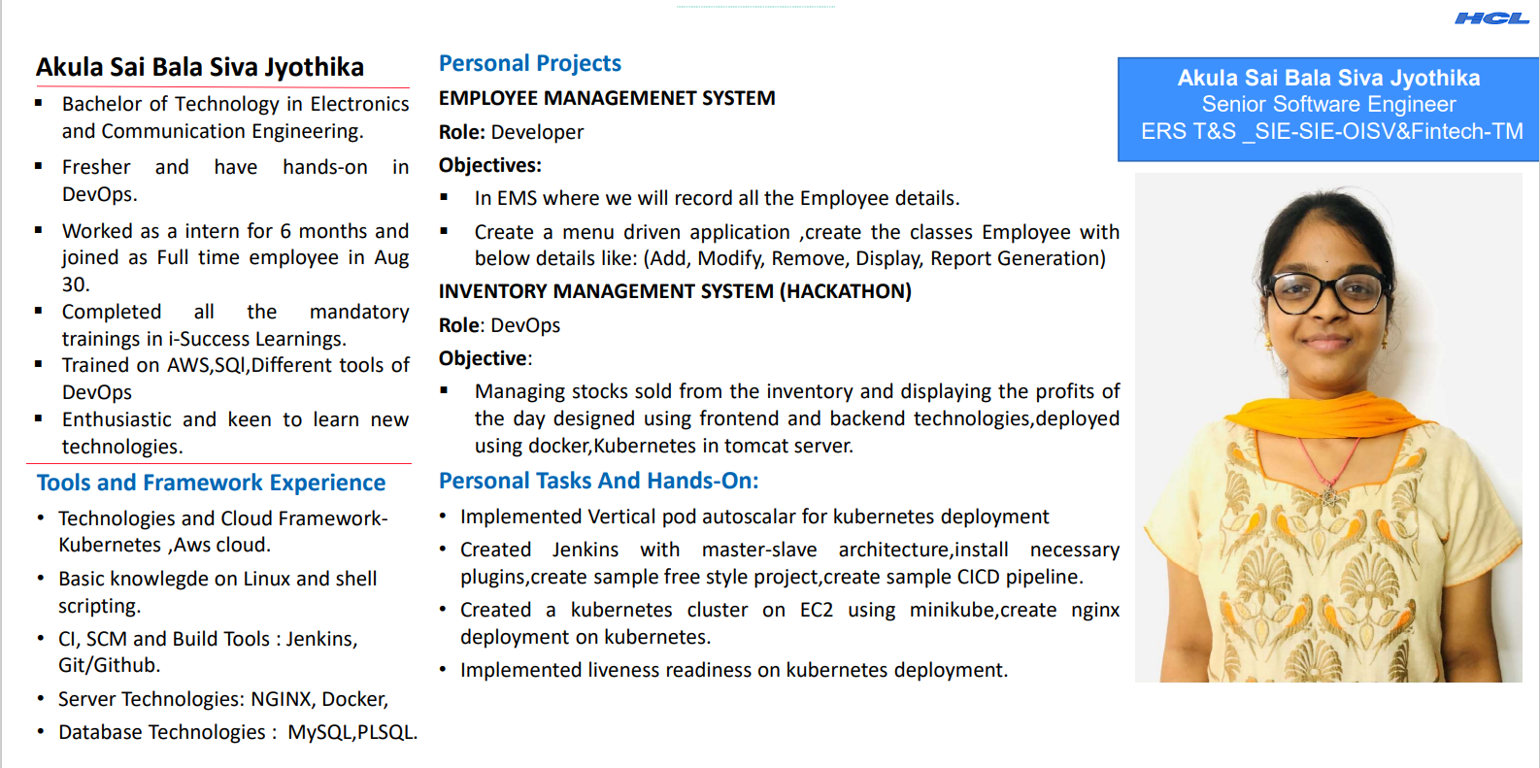

Slide 3
Information Technology Infrastructure Library
Information Technology Infrastructure Library is a framework which helps IT professionals for delivering best services of IT.
It provides a framework within an organization, which helps in planning, measuring, and implementing the services of IT.
Services provided by ITIL are
Cloud services
Data processing and storage
IT consulting
Help desk support
IOT
Network security

Slide 4
Information Technology Infrastructure Library is classified into 5 categories as follow:
Service Strategy
Service Design
Service Transition
Service Operation
Continual Service Improvement
Incident management comes under Service operation.
Stages of ITIL

Slide 5
Incident Management is the process that determines how business customers view the performance the service and the Service Provider.
Incident includes disruption reported by users.
The incidents are automatically detected and reported by monitoring tools
Based on impact, urgency and priority the incidents are classified.
Impact-measure of effect of incident
Urgency is the length of time until the Incident, has a significant effect on the IT service.
Incident Management

Slide 6
Priority is a way to identify the relative importance of an Incident. Priority allows a common understanding to offer relative importance of Incidents and Problems.
High impact and high urgency would result in a Priority 1 Incident, a low impact and low urgency Incident would be the lowest Priority.
Problem Management will investigate the root cause. Most organizations keep volume metrics like the number of Incidents broken down by Service Provider.
Incident
Management​

Slide 7
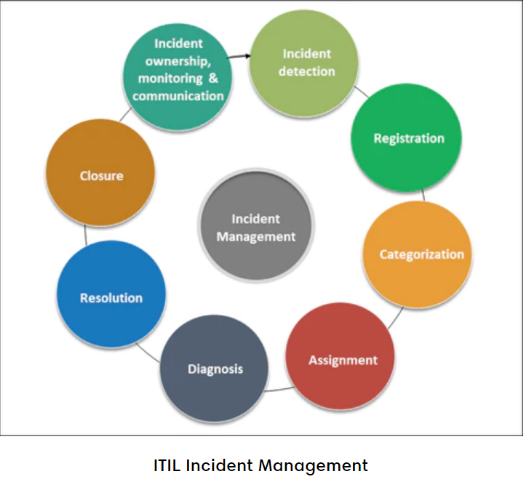
Lifecycle of Incident Management

Slide 8
Incidents are divided into P1,P2,P3,P4,P5 based on severity of incidents.
Detect the incident
Set up team communication channels
Assess the impact and apply a severity level
Communicate with customers
Escalate to the right responders
Delegate incident response roles
Resolve the incident
Steps in Incident management

Slide 9
Faster problem resolution
Prevention of Future Incidents
Better user experience
More operational efficiency
Customer Satisfaction
Advantages of
Incident
Management

Slide 10
Thank you

